Slide 1
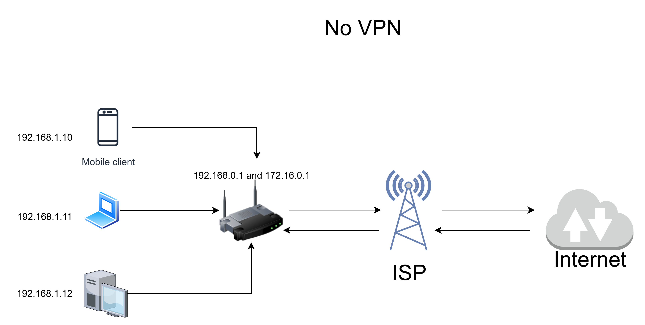

Slide 2
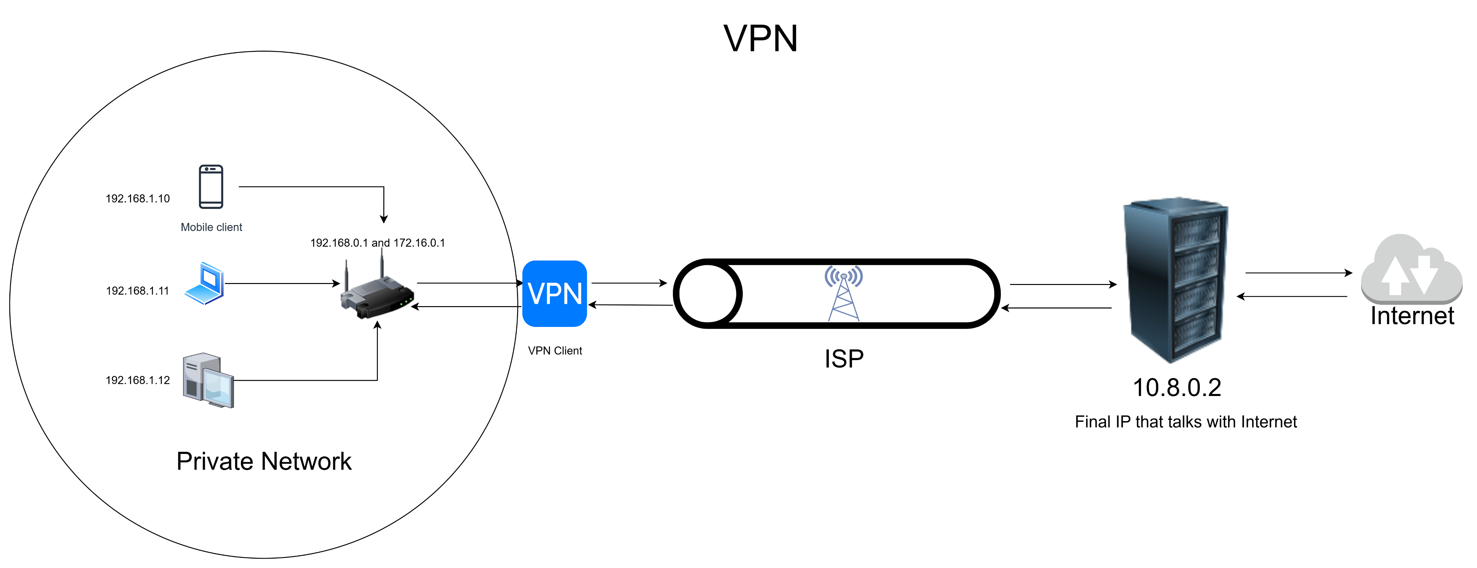

Slide 3
VPN :
A VPN is a secure network technology that creates an encrypted connection (tunnel) between your device and a remote server.It hides your real IP address and protects your internet traffic from being seen or intercepted by others.
Working: You → Encrypted Tunnel → VPN Server → Internet
Features:
Encryption
Speed is slow
Privacy ---- Hides IP and also encrypt Data
Scope ---- Entire Device
---------------------------------------------------------------------------------------------------------------------------------------------------------------------------
PROXY :
A Proxy is an intermediate server that forwards your requests to other websites or servers. It changes your visible IP address, but usually does not encrypt your data.
Working: Browser → Proxy → Website
Features:
No Encryption
Speed is Faster than VPN
Privacy ---- Hides IP
Scope ---- Specific app/browser

Slide 4
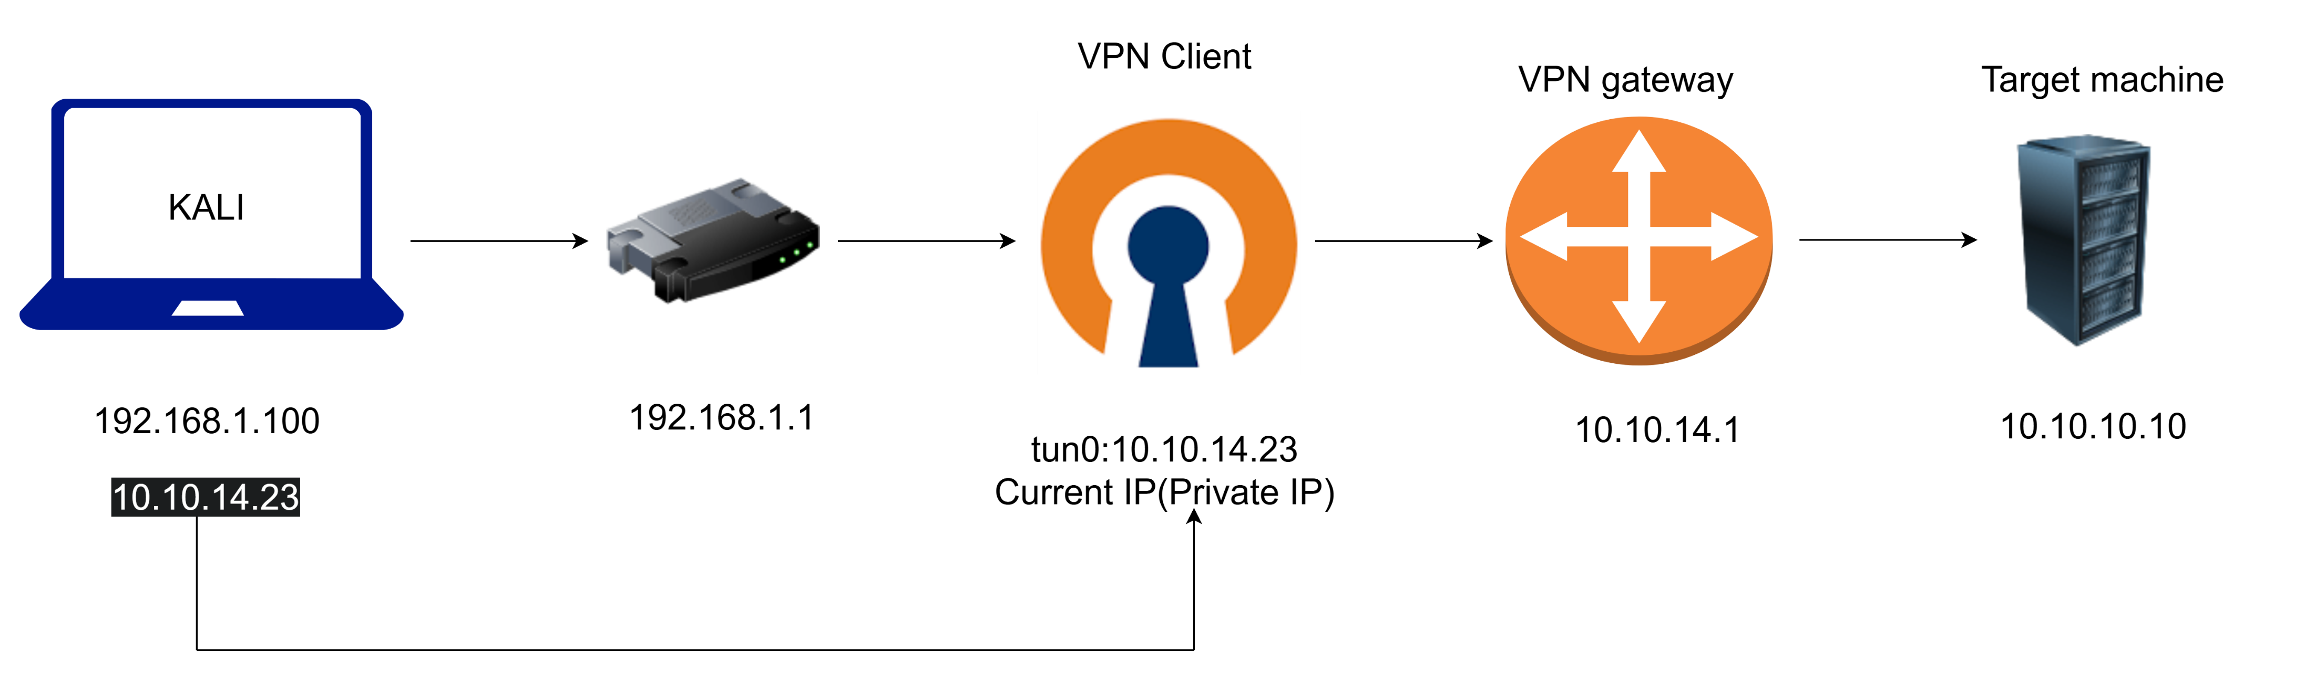
Working Of the vpn 0f Hack the Box:
First of all It does not provide anonymous browsing or privacy basically the HTB VPN connects your machine to Hack The Box's private lab network.

